Slide 1
Command Line and
Git

Slide 2
Learning Objectives
Part 1: The UNIX Command Line
What is it and why use it?
Movin’ around
Lookin’ at things
Makin’ things
Part 2: Git
What is version control, and why use it?
The Git workflow
How we use Git in our class

Slide 3
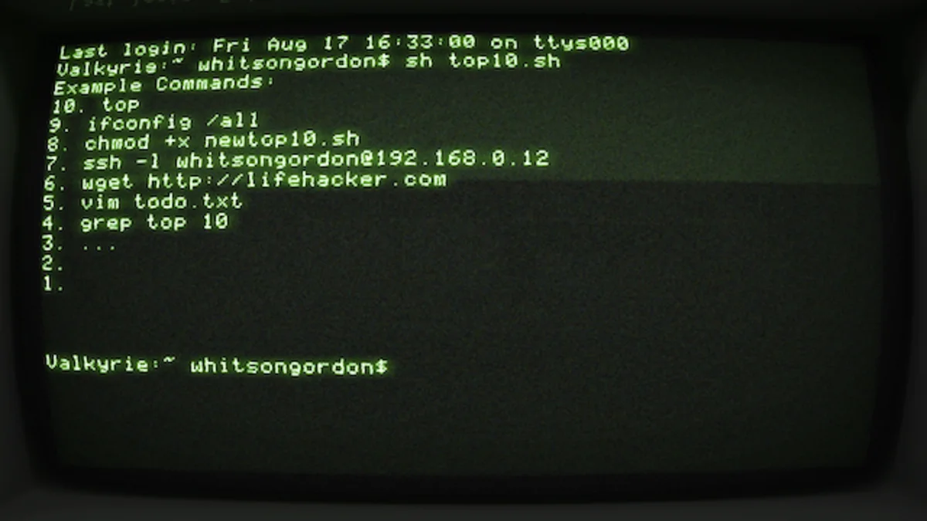
CLI vs GUI
It used to be computers didn’t have a graphical user interface (GUI). You had to do everything via the command line interface (CLI).
Today we take GUIs for granted. Most computer users, if they even know the command line exists, are confused and even a little scared by it. But not you!
https://i.kinja-img.com/gawker-media/image/upload/c_fill,f_auto,fl_progressive,g_center,h_675,pg_1,q_80,w_1200/17waftgjfrx4pjpg.jpg

Slide 4


What is the Command Line?
We’ll use the CL for all sorts of things.
Why do you think it might be more beneficial to use a text-based CLI rather than a GUI?
https://securecdn.pymnts.com/wp-content/uploads/2019/12/hacker-Apple-Turkish-NCA-investigation.jpg

Slide 5
Terminal-ogy
The shell is the specific command line language you’re typing in
The go-to industry standard is bash, so that’s what we’ll use
… unless you’re using the newest version of MacOS, in which case you’ll be using Zshell, which is nearly identical
The terminal is the program you use to emulate the shell
If you’re on MacOS, that program is simply called Terminal, but another popular third party choice you can download is iTerm2
If you’re on Windows, that program is Git Bash, although some experienced users might prefer the Windows Subsystem for Linux (WSL)

Slide 6
Let’s get started!
Open up those terminals!

Slide 7
So you’re dropped into a terminal...
Where are we?
pwd = print working directory (where am I right now?)
(We’ll all see something different)

Slide 8
File Paths: root
In UNIX-based systems (ie, Mac and Linux), your folder’s file tree begins at root. The root directory is the folder on your computer that contains everything. It’s denoted simply by a slash (/).
In Windows, Git Bash will emulate this, but it’s not really true. Your C:\ drive is mounted in /c.

Slide 9
File Paths: home
Each user on a computer has a home directory, which is where you start out when you open your terminal. It is often denoted simply with a tilde (~). When I typed, pwd, I saw:
(on Windows)
/c/Users/dan
home dir
root

Slide 10
File Paths: home
Each user on a computer has a home directory, which is where you start out when you open your terminal. It is often denoted simply with a tilde (~). When I typed, pwd, I saw:
(on Windows)
(on Mac)
(on Linux)
/c/Users/dan
/Users/dan
/home/dan
home dir
home dir
home dir
root
root
root

Slide 11
Let’s Walk and Talk
How do we move around our computer?
cd = change directory = move to a certain folder

Slide 12
Absolute Paths
You can cd into a specific directory if you know its exact location. The exact location, starting with root, is a folder’s absolute path. For example:
cd /Users/dan/Documents/project
or…
cd ~/Documents/project
Absolute path
Absolute path
(bash expands ~ to /Users/dan)

Slide 13
Relative Paths
Sometimes you don’t know the exact location of a folder, but you do know it relative to where you currently are. If this is the case, you can also use a relative path. For example, if we’re currently in our home directory,
instead of
cd ~/Desktop/project
we can write
cd Desktop/project
Absolute path
Relative path (to the working directory)

Slide 14
Relative Paths
And again, if we’re on our Desktop, we can write
cd project
But how do I get back up to my desktop? Or my home directory? The notation to “go up” a folder is the double dot (..). And so, from inside this project folder, to go back up to the desktop, you would type:
cd ..
And to go up to your home directory:
cd ../..
(go up one level)
(go up two levels)

Slide 15
Shortcuts
cd (with no path given) | Go to home
cd ~ | Go to home
cd .. | Go up
cd . | Do nothing (. = “this folder”)
cd - | Go back to last directory

Slide 16
Look Around
The ls command is used to list our all the files and folders in a given directory.
You Try:
Go to your Downloads folder.
Look at what is inside it.
Go back to your home folder.

Slide 17
Makin’ Stuff

Slide 18
Creating Directories
You can use the mkdir command to create a new directory
You Try:
Make a folder on your desktop called tutorial and then navigate into it.

Slide 19

Let’s Explore our Development Environment
Make sure you’re in this new directory. Let’s run the jupyter notebook command to execute the Jupyter Notebook software.
Let’s play around here and make a quick notebook.

Slide 20
Let’s make a quick empty file
You can use the touch command to make an empty file.
Use touch to make a hello.py and goodbye.py file in our tutorial folder.

Slide 21
Let’s Make a Python Script!
You can use the echo command to send text to stdout (“standard output”).
echo 'Hello, world!’
By default, stdout is the terminal – so it displays on your screen.

Slide 22
Let’s Make a Python Script!
We can redirect stdout elsewhere by using > … for example to a file! Let’s create our first Python script this way.
echo 'print("Hello, world!")' > hello.py
This is one of many reasons why Linux is so powerful. You can send the output of any program directly to a file -- or even to another program as its input!

Slide 23
Hello, World!
Not only is Python a programming language… it’s also a program! Actually, it’s a program that runs programs! We can run this file with the python command (python3 on some Linux and MacOS versions).
To run our program, we can simply run
python hello.py
But what if our file changes? How can we keep track…?

Slide 24
Cheat Sheet
cd /path/to/folder | Change directory (move)
pwd | Print working directory (where am I now?)
ls | List everything where I am
mkdir folder-name | Make a folder called folder-name
touch file-name.py | Make an empty text file called file-name.py
echo string | Sends string to stdout.

Slide 25

Optional: Let’s Edit!
To edit a plain old text file, we typically would use a text editor. There are millions of them out there, and experienced programmers debate which is best very fiercely. Right now, the three most popular ones are Atom, VS Code, and Sublime. We asked you to install Atom, so that’s what we’ll work with today.
Open up Atom using your GUI if you’d like. An additional way to do is to run atom . from the command line.

Slide 26
Version Control
with Git

Slide 27
What is Git?
Git is version control software. Why would you need such a thing?

Slide 28
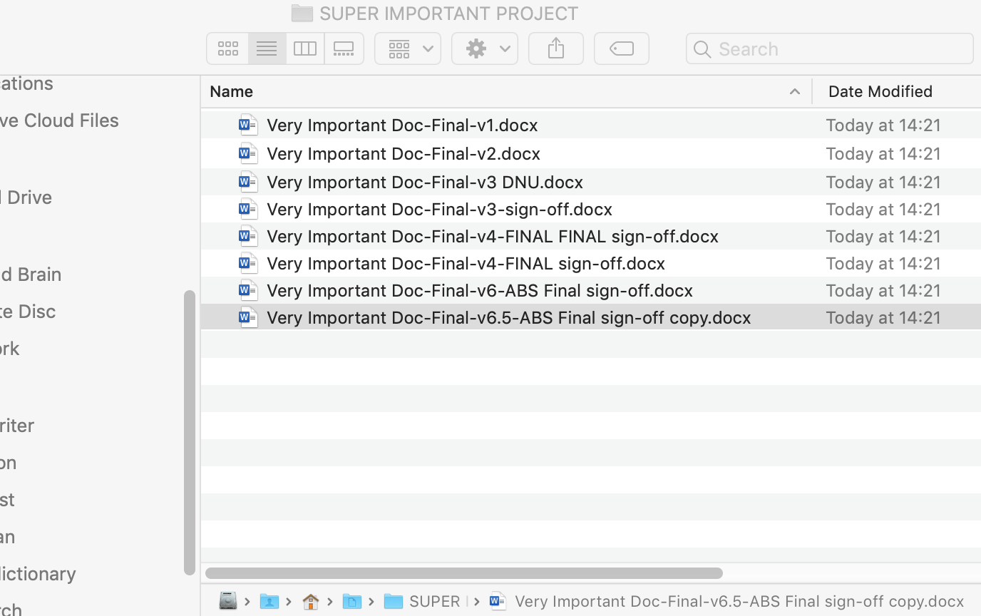
What is Git?
Git is version control software. Why would you need such a thing?
Screenshot from Charlie Rice

Slide 29

Git solves this (for text files)!
Git was created by legendary programmer Linus Torvalds, the same man who brought us Linux.
It was actually written in 2005 as a tool to help maintain the Linux kernel itself! He named it Git, since everyone was calling him a git (slang for a grumpy old man).
Linus + UNIX = Linux
https://cdn.britannica.com/99/124299-050-4B4D509F/Linus-Torvalds-2012.jpg

Slide 30
Too Many Gits
Git | A distributed version control system.
Git Bash | A very bad name for a Bash terminal emulator. A better name might be “(Minimal) Bash with Git.”
Github | A popular website for hosting Git repositories. Think “Instagram for programmers.”
Github Enterprise | A commercial version of Github. General Assembly pays a lot of money annually for our own private Github Enterprise server.

Slide 31
The Git Workflow
Remote
(Github)
We’ll talk about all of this step-by-step soon.
Working Directory
Staging Area
HEAD

Slide 32
First: Let’s Wrangle a Repo
There are two ways to create a repository:
Start one from scratch via the command line.
Create one using Github and “clone” it onto our own machines.

Slide 33
First: Let’s Wrangle a Repo
There are two ways to create a repository:
Start one from scratch via the command line.
Create one using Github and “clone” it onto our own machines.

Slide 34
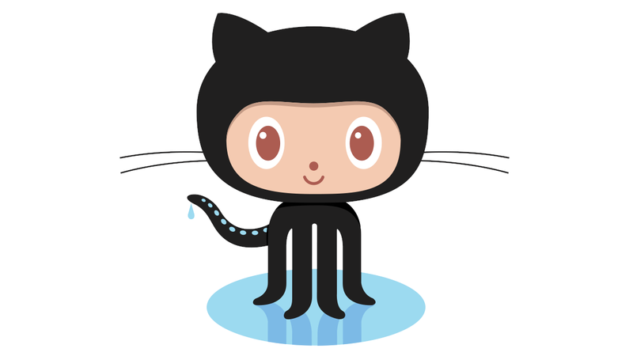
Let’s do that!
Let’s create a repo named my-first-repo now!

Slide 35
Bringing Things Down to Local
Remote
(Github)
To get our repos locally, we’ll have to download, or “clone” them from the remote:
git clone ...
Working Directory
Staging Area
HEAD

Slide 36
Be the change you wish to see in the repo
Let’s create a quick greet.py file in our repo.

Slide 37
Status Checking
Remote
(Github)
At any point in this whole process, if we’re in a repo, we can check what Git knows about by typing
git status
Working Directory
Staging Area
HEAD

Slide 38
Staging Changes
Remote
(Github)
We’ve just made a change to our working directory. The next step is to save this change by staging it.
git add .
Working Directory
Staging Area
HEAD

Slide 39
Staging Changes
Remote
(Github)
git add .
“My changes are ready to be permanent, but they’re not yet committed.”
“I’ve changed, but no one knows about it yet.”
Working Directory
Staging Area
HEAD

Slide 40
Staging Changes
Remote
(Github)
“Everything in this folder”
git add .
“My changes are ready to be permanent, but they’re not yet committed.”
“I’ve changed, but no one knows about it yet.”
Working Directory
Staging Area
HEAD

Slide 41
Committing to Change
Remote
(Github)
Next, we need to make our changes permanently recorded by committing them.
git commit -m 'fixed bug on line 15'
Working Directory
Staging Area
HEAD

Slide 42
Committing to Change
git commit -m 'fixed bug on line 15'
“My changes are ready to be permanent, but they’re not yet committed.”
“My changes have been permanently committed, I’m ready for the world to see!”
“I’ve changed, but no one knows about it yet.”
Working Directory
Staging Area
HEAD

Slide 43
Publishing our Work
Remote
(Github)
Finally, we can push our HEAD to the remote. In practice, this is Github. In our class, it will be Github Enterprise.
git push
Working Directory
Staging Area
HEAD

Slide 44
Git Workflow
git add . | Add changes to staging area
git commit -m ‘msg’ | Commit changes permanently
git push | Push committed changes to Github
git status | Ask Git what’s going on. You can do this anytime, and should do it often!

Slide 45
Git Workflow
git add . | Add changes to staging area
git commit -m ‘msg’ | Commit changes permanently
git push | Push committed changes to Github
git status | Ask Git what’s going on. You can do this anytime, and should do it often!
Now you:
Make another change and push it to your repo!

Slide 46
Git is a timeline of nodes
Why do we have to go through all these steps? It’s so we can time travel if we make a mistake. In more advanced workflows, we can even branch off from our timeline to make different versions of our project.
HEAD
A
B
C
D
E
F
G
Initial commit
Added index file
Commented code
Added data preprocessing
Model gridsearching
Typo in README
Fixed bug on line 15

Slide 47
Git for Course Lessons

Slide 48
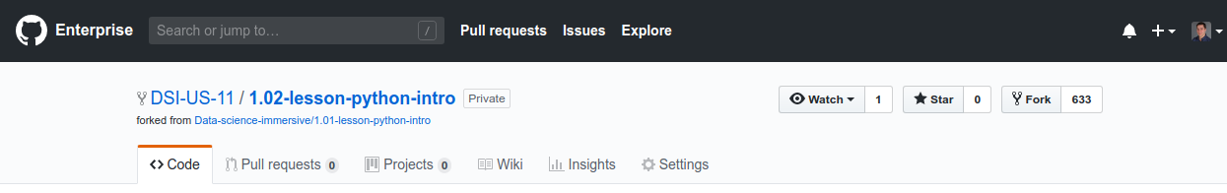
Where do lessons come from?
In our course, we also use Github as a course management system. Our lessons are Git repos, and you’ll fork and clone them before each lesson.

Slide 49
Where do lessons come from?
We do this so that I (the instructor) can push the work we did in class so you can see it later, while also maintaining your own private versions backed up on Github Enterprise.

Slide 50
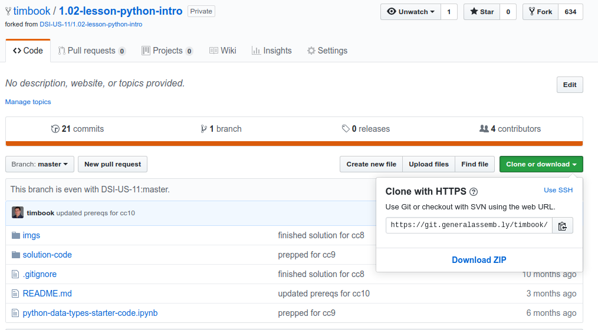
Make sure you clone your repo!

Slide 51
The Most Important Part!
Together, let’s do the following:
Fork the first Python lesson
Create a personal class folder and clone our lesson into it
Navigate into it and open our Jupyter Notebook
Run one line of code

Slide 52
Summary
What did we do today?
Learned some basic command line
Movin’ with cd
Lookin’ with ls and pwd
Makin’ with mkdir and touch
Git
The Git workflow
How to use Git to get our course material

Slide 53
Cheat Sheet
cd /path/to/folder | Change directory (move)
pwd | Print working directory (where am I now?)
ls | List everything where I am
mkdir folder-name | Make a folder called folder-name
touch file-name.py | Make an empty text file called file-name.py
echo string | Sends string to stdout.

Slide 54
Git Workflow
git add . | Add changes to staging area
git commit -m ‘msg’ | Commit changes permanently
git push | Push committed changes to Github
git status | Ask Git what’s going on. You can do this anytime, and should do it often!

